Slide 1

Multiple Color Detection & Object Center Tracking
Presented By: S. Sravya
Batch No. : 450

Slide 2
About me
I am Sribhashyam Sravya, I have completed my B.Tech CSE (AIML) student at Sphoorthy Engineering College. I am eager to learn Data Science because I want to analyze and solve real-world problems using technology.
Linkedin : https://www.linkedin.com/in/sribhashyam-sravya-268b4527b
Github : https://github.com/SribhashyamSravya

Slide 3
Agenda
1. Introduction & Problem Statement
2. Objectives
3. Tools & Technologies Used
4. System Architecture
5. Methodology
6. Object Center Tracking Logic
7. Web Application (Streamlit)
8. Results & Applications
9. Conclusion & Future Scope

Slide 4
Introduction & Problem Statement
Introduction
Color detection is an important Computer Vision task used in automation and robotics.
Problem Statement
Need to detect multiple colored objects in real-time
Track object center coordinates
Provide easy web-based interface
Ensure accurate and fast detection

Slide 5
Objectives
Detect Red, Green, Blue, Yellow colors
Draw bounding box around detected objects
Calculate object center (X, Y coordinates)
Track object continuously
Deploy as web application

Slide 6
Tools & Technologies Used
Programming Language
Python
Libraries
OpenCV
NumPy
Streamlit
Development & Deployment
VS Code
GitHub

Slide 7
System Architecture
Camera Input
⬇
Convert BGR → HSV
⬇
Color Mask Creation
⬇
Noise Removal (Dilation)
⬇
Contour Detection
⬇
Bounding Box + Center Calculation
⬇
Display in Web App

Slide 8
Methodology
1. Capture frame from webcam
2. Convert image to HSV
3. Define HSV color ranges
4. Create mask using `cv2.inRange()`
5. Detect contours
6. Draw bounding box
7. Calculate and mark center point
8. Display results

Slide 9
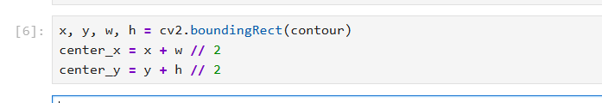
Object Center Tracking Logic
After detecting contour:
System displays:
Rectangle around object
White center point
Center coordinates
This enables real-time object tracking.

Slide 10
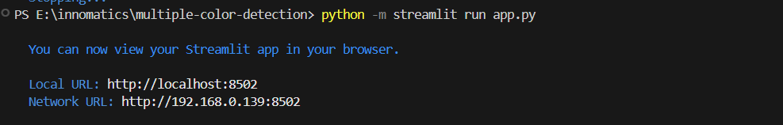
Web Application (Streamlit)
Features:
Start/Stop Camera
Real-time multi-color detection
Displays object center coordinates
Clean user interface
Run using:

Slide 11
Results & Applications
Results
Accurate multi-color detection
Real-time tracking
Stable performance
Applications
Industrial automation
Robotics
Traffic signal detection
Smart surveillance

Slide 12
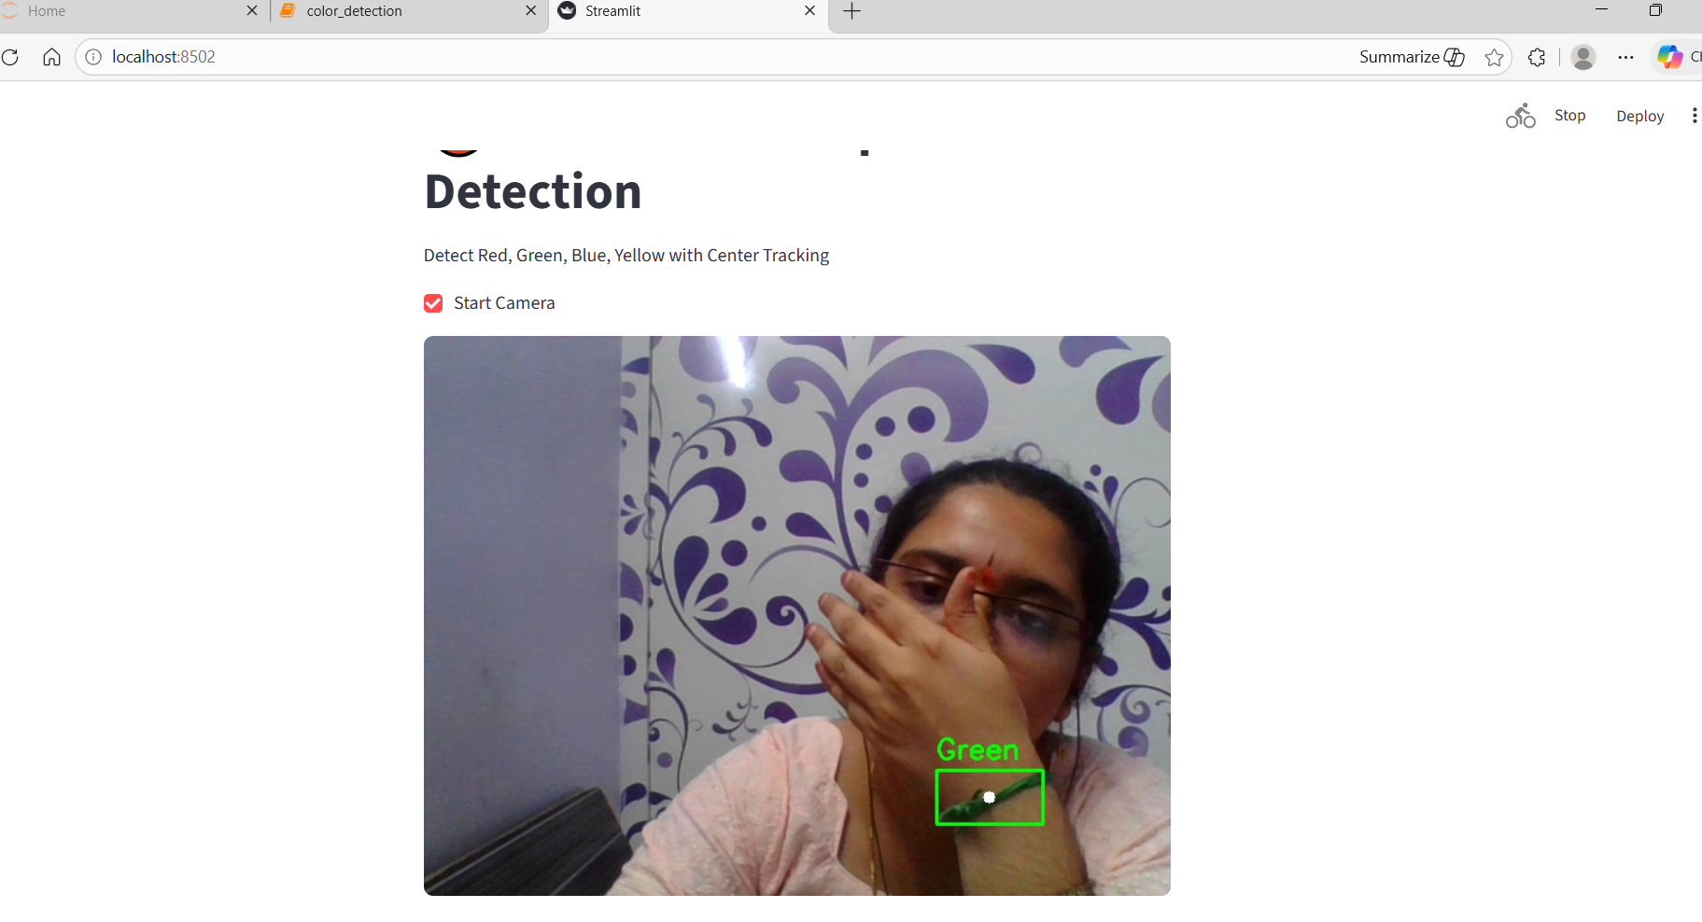
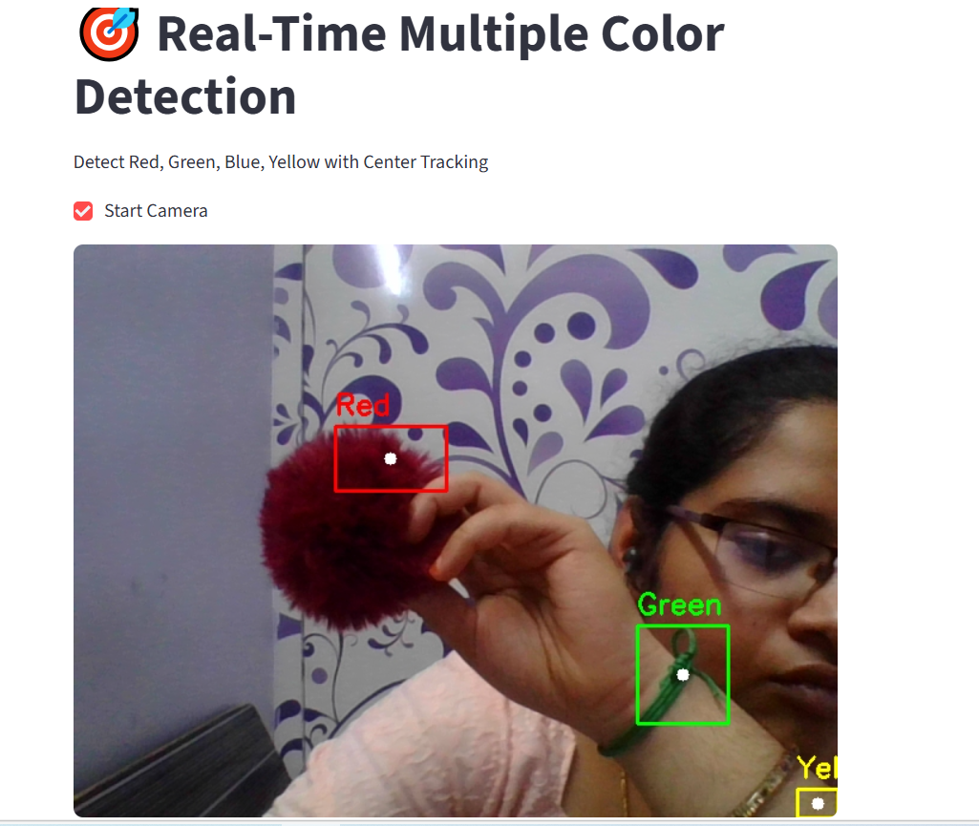
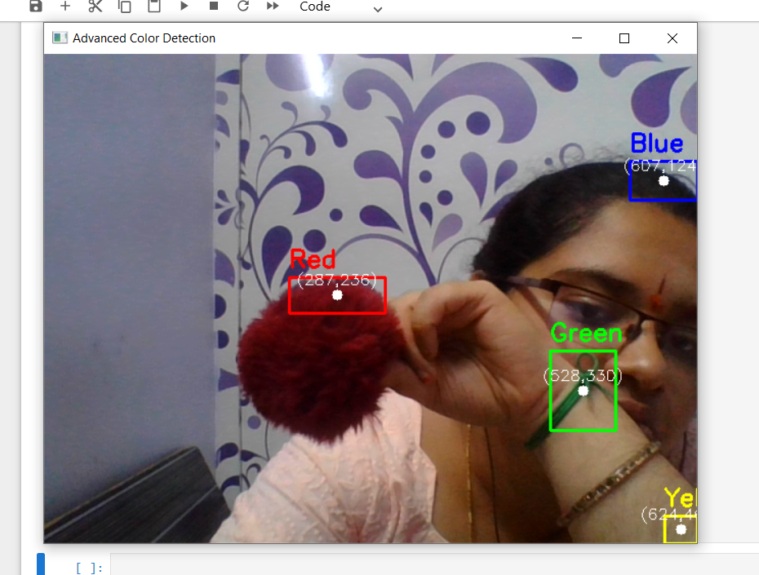
Results

Slide 13
Conclusion & Future Scope
Conclusion
Successfully implemented real-time color detection
Added object center tracking
Converted to web application
Future Enhancements
Add object counting
Add motion tracking
Improve lighting adaptability
Add dashboard analytics

Slide 14

THANK YOU

